Slide 1
Assembler
Assembler is system software which is used to convert an assembly language program to its equivalent object code.
The input to the assembler is a source code written in assembly language (using mnemonics) and the output is the object code.
The design of an assembler depends upon the machine architecture as the language used is mnemonic language.
Assembly language code
Assembler
Object code

Slide 2
Design of Assembler
Convert mnemonic operation codes to their machine language equivalents
Convert symbolic operands to their equivalent machine addresses
Decide the proper instruction format
Convert the data constants to internal machine representations
Write the object program and the assembly listing
The assembler design can be done:
  Single pass assembler
  Multi-pass assembler

Slide 3
Single Pass Assembler
The whole process of scanning, parsing, and object code conversion is done in single pass.
The only problem with this method is resolving forward reference.
See example 2.1 later.

Slide 4
Multi Pass Assembler
Resolves the forward references and then converts into the object code.
Pass-1
  Assign addresses to all the statements
  Save the addresses assigned to all labels to be used in Pass-2
  Perform some processing of assembler directives such as RESW, RESB to find the length of data areas for assigning the address values.
  Defines the symbols in the symbol table(generate the symbol table)
Pass-2
  Assemble the instructions(translating operation codes and looking up addresses)
  Generate data values defined by BYTE, WORD etc.
  Perform the processing of the assembler directives not done during pass-1
  Write the object program and assembler listing

Slide 5
Assembler Design
The most important things which need to be concentrated is the generation of Symbol table and resolving forward references.
Symbol Table:
This is created during pass 1
All the labels of the instructions are symbols
Table has entry for symbol name, address value.
Forward reference:
Symbols that are defined in the later part of the program are called forward referencing.
There will not be any address value for such symbols in the symbol table in pass 1.

Slide 6
Main Functions
Translate mnemonic operation codes to their machine language equivalents
Assign machine addresses to symbolic labels used by the programmers
Depend heavily on the source language it translates
and the machine language it produces.
E.g., the instruction format and addressing modes

Slide 7
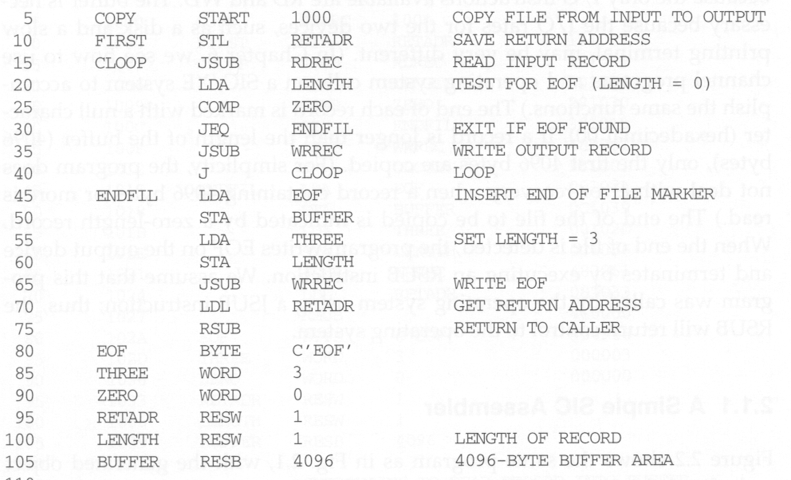
Example 2.1
Line numbers are not part of the program. They are for
reference only.
Forward reference
Call subroutine
code

Slide 8
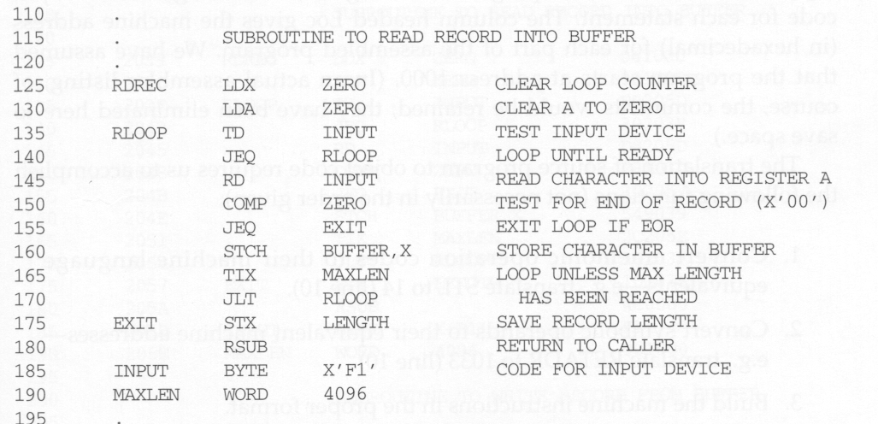
Comment line
Hexadecimal number
Indexing mode

Slide 9
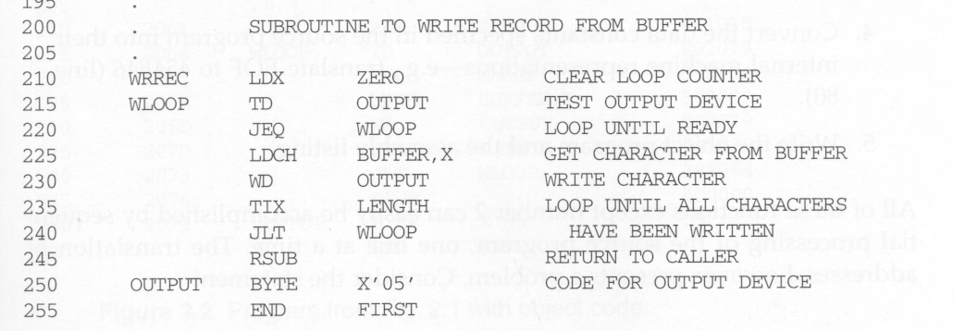
Subroutine entry point
Subroutine return point

Slide 10
Example 2.1
Line numbers are not part of the program. They are for
reference only.
Forward reference
Call subroutine
code

Slide 11
Comment line
Indexing mode
Hexadecimal number

Slide 12
Subroutine entry point
Subroutine return point

Slide 13
Purpose of Example 2.1 (COPY)
It is a copy function that reads some records from a specified input device and then copies them to a specified output device
  Reads a record from the input device (code F1)
  Copies the record to the output device (code 05)
  Repeats the above steps until encountering EOF.
  Then writes EOF to the output device
  Then call RSUB to return to the caller

Slide 14
RDREC and WRREC
Data transfer
  A record is a stream of bytes with a null character (00₁₆) at the end.
  If a record is longer than 4096 bytes, only the first 4096 bytes are copied.
  EOF is indicated by a zero-length record. i.e., a byte stream with only a null character.
  Because the speed of the input and output devices may be different, a buffer is used to temporarily store the record
Subroutine call and return
  On line 10, “STL RETADDR” is called to save the return address that is already stored in register L.
  Otherwise, after calling RD or WR, this COPY cannot return back to its caller.

Slide 15
Assembler Directives
Assembler directives are pseudo instructions
  They will not be translated into machine instructions.
  They only provide instruction/direction/information to the assembler.
  No memory location, no object code.
Basic assembler directives :
  START :
    Specify name and starting address for the program
  END :
    Indicate the end of the source program, and (optionally) the first executable instruction in the program.

Slide 16
Assembler Directives (cont’d)
  BYTE :
    Generate character or hexadecimal constant, occupying as many bytes as needed to represent the constant.
  WORD :
    Generate one-word integer constant
    Reserve a word of memory and store constant in memory.
  RESB :
    Reserve the indicated number of bytes for a data area.
    First convert given value into hex
  RESW :
    Reserve the indicated number of words for a data area
    Do not store constant in memory

Slide 17
An Assembler’s Job
Convert mnemonic operation codes to their machine language codes
  e.g. translate STL to 14 , JSUB to 48 etc
Convert symbolic (e.g., jump labels, variable names) operands to their machine addresses
  e.g. translate RETADR to 1033 , RDREC to 2039 etc
Use proper addressing modes and formats to build efficient machine instructions
Translate data constants into internal machine representations
  e.g. translate EOF to 454F46
Output the object program and provide other information (e.g., for linker and loader)

Slide 18
Object Program
Object Program will be loaded in memory for execution.
Three types of records:
  Header: program name, starting address, length
  Text: Starting address, length, object code
  End: address of first executable code
The symbol ^ is used to separate fields.

Slide 19
Object Program Format
Header
  Col. 1 H
  Col. 2~7 Program name
  Col. 8~13 Starting address of object program (hex)
  Col. 14-19 Length of object program in bytes (hex)
Text
  Col.1 T
  Col.2~7 Starting address for object code in this record (hex)
  Col. 8~9 Length of object code in this record in bytes (hex)
  Col. 10~69 Object code, represented in hexa (2 col. per byte)
End
  Col.1 E
  Col.2~7 Address of first executable instruction in object program (hex)

Slide 20
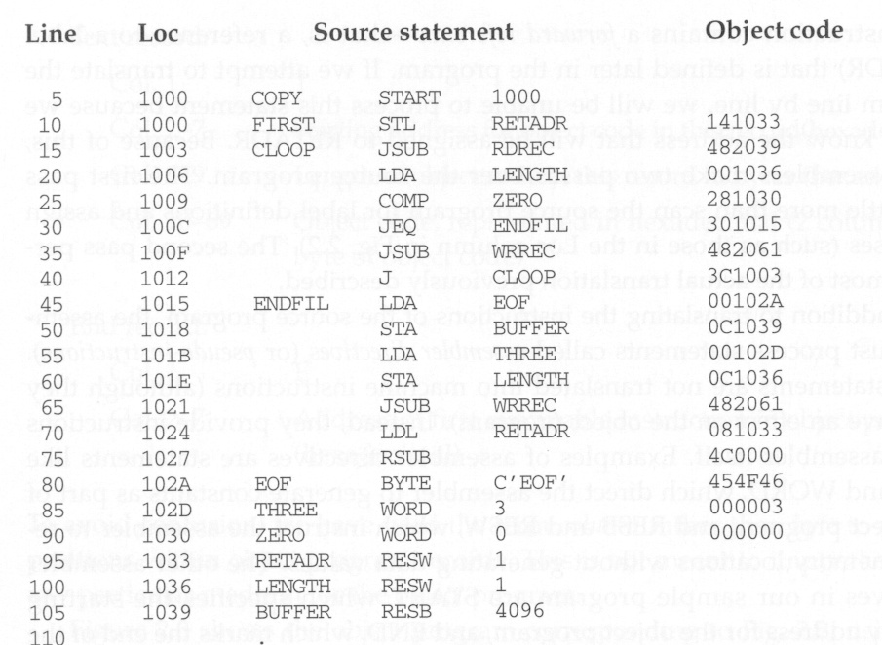

Slide 21
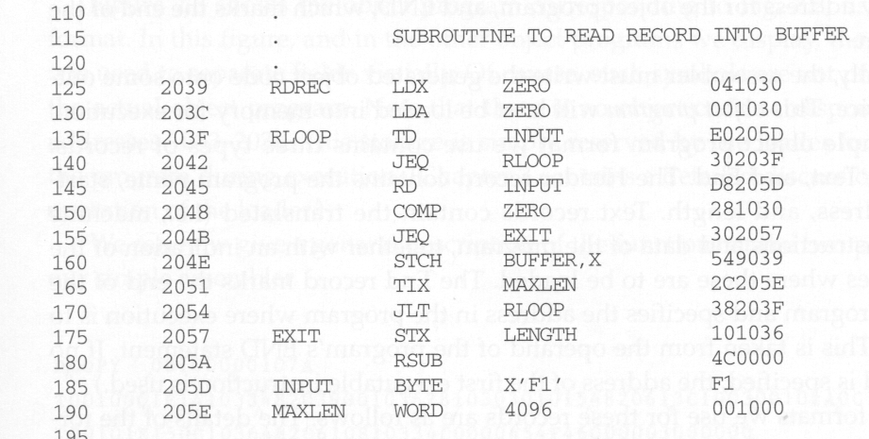

Slide 22
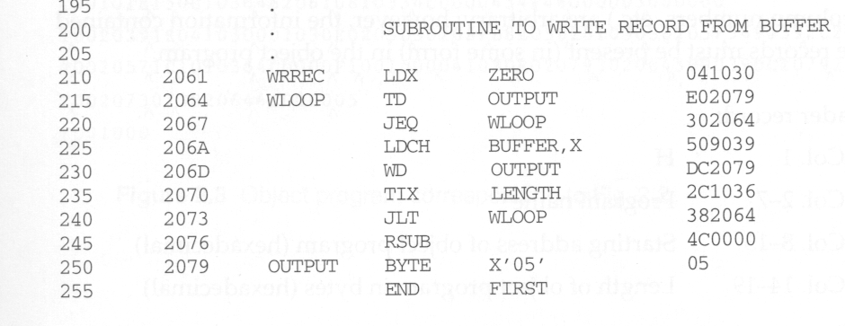

Slide 23
The Object Code for COPY
H COPY 001000 00107A
T 001000 1E 141033 482039 001036 281030 301015 482061 3C1003 00102A 0C1039 00102D
T 00101E 15 0C1036 482061 081044 4C0000 454F46 000003 000000
T 002039 1E 041030 001030 E0205D 30203F D8205D 281030 302057 549039 2C205E 38203F
T 002057 1C 101036 4C0000 F1 001000 041030 E02079 302064 509039 DC2079 2C1036
T 002073 07 382064 4C0000 05
E 001000
There is no object code corresponding to addresses 1033-2038.
This storage is simply reserved by the loader for use by the
program during execution.

Slide 24
Two Pass Assembler
Pass 1
  Assign addresses to all statements in the program
  Save the values (addresses) assigned to all labels (including label and variable names) for use in Pass 2 (deal with forward references)
  Perform some processing of assembler directives (e.g., BYTE, RESW, these can affect address assignment)
Pass 2
  Assemble instructions (generate opcode and look up addresses)
  Generate data values defined by BYTE, WORD
  Perform processing of assembler directives not done in Pass 1
  Write the object program and the assembly listing

Slide 25
A Simple Two Pass Assembler Implementation
Source
program
READ (Label, opcode, operand)
Pass 1
Pass 2
Object
codes
OPTAB
SYMTAB
SYMTAB
Mnemonic and
opcode mappings
are referenced from
here
Label and address
mappings enter
here
Label and address
mappings are referenced
from here

Slide 26
Three Main Data Structures
Operation Code Table (OPTAB)
Location Counter (LOCCTR)
Symbol Table (SYMTAB)

Slide 27
OPTAB (operation code table)
Content
  The mapping between mnemonic and machine code. Also include the instruction format, available addressing modes, and length information.
Characteristic
  Static table. The content will never change.
Implementation
  Array or hash table. Because the content will never change, we can optimize its search speed.
In pass 1, OPTAB is used to look up and validate mnemonics in the source program.
In pass 2, OPTAB is used to translate mnemonics to machine instructions.

Slide 28
Location Counter (LOCCTR)
This variable can help in the assignment of addresses.
It is initialized to the beginning address specified in the START statement.
After each source statement is processed, the length of the assembled instruction and data area to be generated is added to LOCCTR.
Thus, when we reach a label in the source program, the current value of LOCCTR gives the address to be associated with that label.

Slide 29
Symbol Table (SYMTAB)
Content
  Include the label name and value (address) for each label in the source program.
  Include type and length information (e.g., int64)
  With flag to indicate errors (e.g., a symbol defined in two places)
Characteristic
  Dynamic table (I.e., symbols may be inserted, deleted, or searched in the table)
Implementation
  Hash table can be used to speed up search
  Because variable names may be very similar (e.g., LOOP1, LOOP2), the selected hash function must perform well with such non-random keys.

Slide 30


